Slide 1
Računalništvo v oblaku Office 365
Andrej Kunej; andrej.kunej@microsoft.com
Microsoft Slovenija

Slide 2





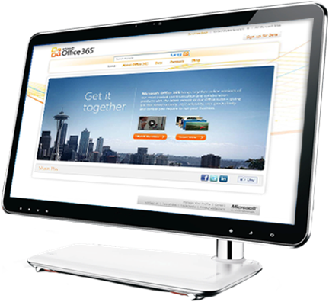


Office 365 – gradniki
Notes:
Microsoft® Office 365 delivers the power of cloud productivity to businesses of all sizes, helping to save time, money and free up valued resources. Office 365 combines the familiar Office desktop suite with cloud-based versions of Microsoft’s next-generation communications and collaboration services: Exchange Online, SharePoint Online and Lync Online. Office 365 is simple to use and easy to administer – all backed by the robust security and guaranteed reliability you expect from a world-class service provider.
Microsoft Office 365 Includes:
Microsoft® Office Professional Plus
The world’s leading productivity tool now seamlessly connected and delivered with cloud services – for the best productivity experience across the PC, Phone and Browser.
Exchange Online
Cloud-based email, calendar and contacts with always-up-to-date protection from viruses and spam.
SharePoint Online
Cloud-based service for creating sites to connect colleagues, partners and customers.
Lync Online
Cloud-based instant messaging, presence, and online meeting experiences with PC-audio, video conferencing and screen sharing.
Key Microsoft Office 365 Benefits:
Anywhere-access to email, documents, contacts, and calendars on nearly any device
Work seamlessly with Microsoft Office and the other programs your users already count on everyday
Business-class features including IT-level phone support, guaranteed 99.9% uptime, geo-redundancy, and disaster recovery
Pay-as-you-go pricing options which give you predictability and flexibility for all or part of your organization
Latest version of Business Productivity Online Suite (BPOS), which has millions of business users today
Microsoft® Office 365 for small businesses offers an easy-to-use set of web-enabled tools for small businesses, independent consultants and professionals looking for business-class productivity services. Working with the tools people know and use today, Office 365 provides anywhere access to email, important documents, contacts, and calendars on nearly any device. It’s free for the first 30 days and then just $6 per user per month.
Microsoft® Office 365 for enterprises brings together cloud versions of our trusted communications and collaboration software with our familiar Office Professional Plus desktop suite. It is designed to help meet your IT needs for robust security, 24/7 reliability, and user productivity.
We have a variety of plans to meet the needs of businesses of all sizes and varying IT needs. Priced from $2 - $28 per month per user, each plan has the same 99.9% uptime guarantee and includes the security and support you expect from Microsoft. Office 365 offers great flexibility by allowing businesses to provide users access to only the services they need and pay-as-you-go pricing options.
Microsoft® Office 365 for education provides your institution with the same great communication and collaboration experiences used in enterprises around the world while saving time and money. Microsoft Office 365 for education delivers all of this and more while training students on familiar software which employers depend upon.

Slide 3

Fleksibilen način licenciranja na uporabnika, za krajše obdobje
Polna Office izkušnja in integracija z Office 365
Vedno razpoložljiva najnovejša različica klienta
Office Web Apps
Znana uporabniška izkušnja
Odlična uporabniška izkušnja preko spleta z Outlook Web App
Preprostejše upravljanje pošte
Vgrajene možnosti iskanja po poštnih predalih
Nastavljanje politik arhiviranja
Večja kontrola z novim GUI in Remote Power Shell
25 GB na uporabnika
Protivirusna zaščita elektronske pošte
My sites za lastne datoteke do katerih lahko dostopamo od koderkoli
Team in Project sites za skupinsko delo
Extranet Sites za varno delitev informacij s strankami in partnerji
Intranet sites za objavo novic in ostalih informacij za vse zaposlene
Preproste Web strani
Obilo prostora - 10GB/tenant + 500 MB/user
Znotraj ene aplikacije združuje 1:1 tekstovno/ glasovno/video komunikacijo z možnostjo skupinskih spletnih sestankov
Preprost prehod v spletne sestanke z možnostjo delitve dokumentov in namizja
Poenostavljen dostop na sestanke zunanjim osebam
Osebni podatki s slikami
Federacija z Windows Live Messenger
Učinkovita uporabniška izkušnja
Opozorilo: Posamezne funkcionalnosti niso na voljo v vseh paketih
Notes:
All services have been improved across the board with new services, features, capabilities, and user experience. For specific detailed information about each major service, please see the specific service and technical information documentation and presentations.
Office Professional Plus is the latest 2010 version of the applications and will always be up to date, along with Office Web Apps, companion applications to Office client apps.
Exchange Online, SharePoint Online, and Lync Online are all based on the 2010 server technologies.

Slide 4
Office 365 – prednosti
Dostop od kjerkoli
Varnost in zanesljivost
Nadzor in upravljanje
Poslovne prednosti
Različne naprave
Različni brskalniki
Brez VPN
SLA: 99,9%
Zaščita pred virusi
Geografska razpršenost
Nazorna plošča
Izvajanje politik na nivoju uporabnika ali dokumenta
Podpora: telefon, portal, partnerji
Nizka začetna investicija
Predvidljivi in fleksibilni mesečni stroški
Nižji skupni stroški
Vrsta scenarijev (hibridov)

Slide 5
Office klient
Sistemske zahteve: Office 2007 ali novejše
Uporabi se lahko klasično pridobljen klient ali Office 365 Professional Plus
Office 365 Professional plus
DL preko spleta
Licenciranje/uporabnika; 5 sočasnih namestitev za enega uporabnika
Preverjanje poteka na drug način
Nadgradnje so nujne v nekem času (12 mesecev)
Office Desktop Setup: pomoč pri množični namestitvi
Manually update and configure desktops for Office 365

Slide 6
Office 365 - paketi
Preproste rešitve (Small business)
Napredne rešitve (Enterprise)
Paket
P1
Paketi
E1, E2, E3, E4
Paketa
K1, K2
Potrebna povezava z AD
Izvajanje politike arhiviranja
Podpora za BlackBerry (BES)
Več kot 50 uporabnikov
Telefonska podpora 24/7
Kdaj P paket ne zadošča?

Slide 7
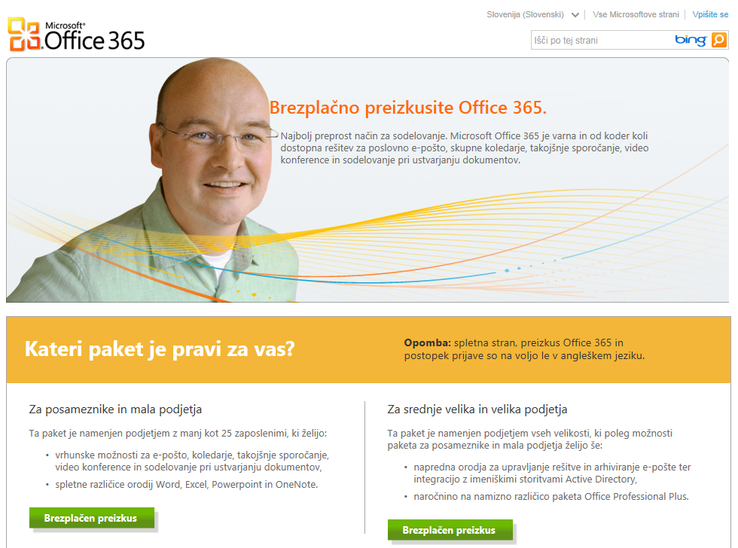
www.office365.si

Slide 8




Office 365 - Small Business
Vsebuje
1-25 uporabnikov (max 50)
Ne potrebuje lokalnega ITja
Preprost za preizkus in uporabo
Dela z Microsoft Office
Finančno kritje v primeru nedelovanja pod 99.9%
Podpora preko javnih gradiv in forumov
ZNAČILNOSTI
Exchange Email, koledar, kontakti & osebni arhiv
25 GB Mailbox
ActiveSync podpora
SharePoint Team Sites ¹
Office Web Apps
Preprosta javna spletna stran ²
Lync klient
Spletni sestanki ³
Delitev namizja
Večosebni IM & PC-PC klici
Office 365
(Plan P1)
5,25€/uporabnika/mesec
Office Professional Plus 16€
¹ One site collection, authenticated external user access enabled for up to 50 unique users/month. ² Includes ready-to-use templates, option to add custom domain.
³ Online meetings limited to 50 participants.

Slide 9


Office 365 - Enterprise
„Kiosk“ Uporabnik
Napreden uporabnik
LOB zaposleni
Dostop do polnih funkcionalnosti za pisarniške uporabnike
3,57€-7,25€/ uporabnika/ mesec
7,25€-20,75€/ uporabnika/ mesec
Plan K (Kiosk)
1000 MB mailbox
Dostop do e-pošte preko Outlook Web App
Podpora POP
Sporočila, koledar, kontakti
Forefront antivirus in anti-spam
Dostop do SharePoint – branje
Iskanje po straneh
Office Web Apps (spletne Office aplikacije)
Plan E (Enterprise)
25GB mailbox
500 MB SharePoint prostora
Povezljivost z Microsoft Office
Podpora mobilnosti
Lync funkcionalnosti
Exchange & SharePoint funkcionalnosti
Office Professional Plus
Pravica dostopa do on-premise
Razlike
Notes:
Much like our BPOS offers today with deskless worker, we’ll have a Kiosk worker offer as part of the K Family. This set of family plans is designed for the user that doesn’t have messaging and collaboration today so it’s a low cost way of expanding your footprint in an account and giving customers a common platform for communicating to their workers.
There are a couple of key changes in this line up from our current deskless offer. The first and foremost is that we are moving from Outlook Web Access Lite to full OWA. In addition, we’ll add POP support for Exchange so this allows customers to access their mail via a client or device.
As we shift to the right-hand side, it’s important to talk about the enterprise IW as well. This really is the high volume family plan. The Plan E family. Designed for your enterprise workers. It includes a larger mailbox at 25 gb, full client connectivity with MAPI, it’s mobility with Active sync, Lync for real-time communication (both instant messaging and conferencing), as well as enterprise features for exchange and Sharepoint. And of course Office Professional Plus. All of these capabilities are part of the Enterprise family. So let’s spend a few minutes diving into the Plan E Family…

Slide 10
Office 365 plani
Kiosk Plan
Enterprise Plan
Plan E4
20,75 € /m
Voice
Office Pro Plus
Plan E3
19,00 € /m
Komponente
Voicemail & Advanced Archive Capabilities
Office Web Apps
10€
Plan K2
7,25 € /m
Forms, Access
Excel, & Visio Services
Office Web Apps
Plan E2
12,50€ /m
SharePoint Online
Kiosk
Plan K1
3,57 € /m
Email, koledar, AV/AS, osebni arhiv (pst)
Plan E1
7,25 € /m
Portal
Exchange Online
Kiosk
1,75 €
Konferenčni sistem
IM & informacija o prisotnosti
Notes:
More detail on plans and what they consist of

Slide 11


Samostojni paketi v E planu
Workload
Standalone SKUs
Key Features
Exchange Online (Plan 1)
3.57€
Email, Calendar, Contacts, Discovery, AV/AS
Exchange Online (Plan 2)
7.25€
Voicemail and archiving
SharePoint Online (Plan 1)
3.57€
Advanced portal for collaboration, AV
SharePoint Online (Plan 2)
7.25€
Forms, data visualization, Access/Excel/Visio Services
Lync Online (Plan 1)
1.79€
Instant Messaging and Presence, AV
Lync Online (Plan 2)
5.00€
Virtual meetings
Office Professional Plus
12.75€
Client productivity applications and Web Apps
Office Web Apps (Plan 1)
9.00€
Web productivity applications and
SharePoint Online Plan 1
Office Web Apps (Plan 2)
$12.50€
Web productivity applications and SharePoint Online Plan 2

Slide 12

Kaj je potrebno upoštevati pri cenovni primerjavi?
Strošek:
Programske opreme (licence) + vzdrževanje
Strojne opreme + vzdrževanje
Nadgradenj
Vzdrževanje celotnega DC (elektrika, agregati, varovanje, požarna varnost, prostor, varovalni sistemi,hladilni sistem….)
Mrežne povezave
WAN (optika za DRC povezavo)
Hramba podatkov (diskovje)
Varnostne kopije
SW, HW, vzdrževanje
Tračna enota
Strošek visoke razpoložljivosti
Strošek oddaljene lokacije (BCP in DR)
Migracije
…………

Slide 13
Tehnološke zahteve
Operacijski sistem:
Windows XP SP3, Windows Vista SP2, Windows 7
10.5 (Leopard), 10.6 (Snow Leopard)
Office
Office 2007 SP2 ali Office 2010
Office 2008 for Mac, Office 2011 for Mac and Outlook 2011 for Mac
.NET 2.0 or later, Lync 2010, Communicator for Mac
Brskalnik
Internet Explorer 7 ali novejša verzija
Firefox 3.x
Safari 4.x
Brskalnik za Outlook Web App
Internet Explorer 7 ali novejša verzija
Firefox 3 ali novejša verzija
Safari 3
Chrome 3 ali novejša verzija

Slide 14


































































































Reference
Consumer Goods, Retail, Distribution
Education, Gov’t, Non Profit
Financial Services, Insurance
High Tech, Electronics
Manufacturing, Industrial
Media & Entertainment
Pharmaceutical, Healthcare
Services, Hospitality
Telecom, Transportation, Energy
Microsoft Confidential
Notes:
Thank you for your additions in FY11. This is additive and includes some of our big brands now on BPOS.

Slide 15
Viri
www.office365.si - preizkusite Office 365 že danes!
Service description dokumenti: opis posamezne storitve (Exchange, SharePoint, Lync, Office WebApps, Office profesional Plus, Support, Security)
Preizkus za posameznike in mala podjetja vključuje licence za 10 uporabnikov:
opis paketa P,
vodič za Trial,
vodič za hiter začetek.
Različica za zahtevnejše uporabnike ter za srednja in večja podjetja vsebuje licence za 25 uporabnikov:
opis paketa E/K,
vodič za Trial.
Dodatne informacije o zbirki Office 365 so na voljo tudi v posebni e-knjigi, uvodnem dokumentu za uporabnike in administratorje ter na spletni strani Microsoftove virtualne akademije za IT-strokovnjake.

